Slide 1
WASH – Maximise the Effort
Subject- Learning from WASH Failures
Presenter – Uday Pilani ( AKS ) Asst Gov Dist 3150,
Date : 14 July 2020, RI Virtual Convention

Slide 2
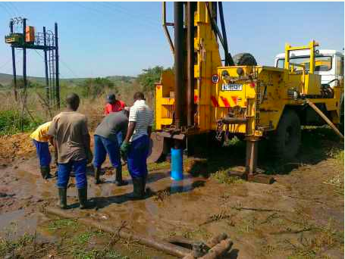
Failure and Learning 1
Borehole with Water Tank at Kano
Rotary club of Bompai, Kano built water system outside Emir’s Palace.
Local community hostile; they wanted a share.
Emir intervened; project went ahead.
Lack of ownership by local community resulted in borehole being vandalized and misused.
Borehole no longer functional.
Loss of US 10,000+ and Man Hours

Slide 3
Failure and Learning 2
Borehole at Obaretin Village in Nigeria:
Community engaged but no involvement of the Government.
Borehole functioned, operated satisfactorily.
Government built a borehole next to Rotary borehole.
Rotary involvement redundant, waste of time and resources.

Slide 4
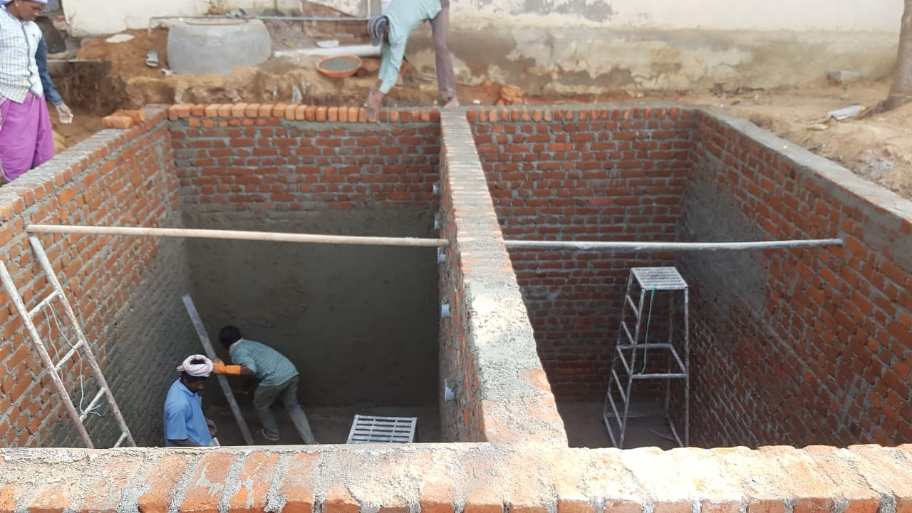
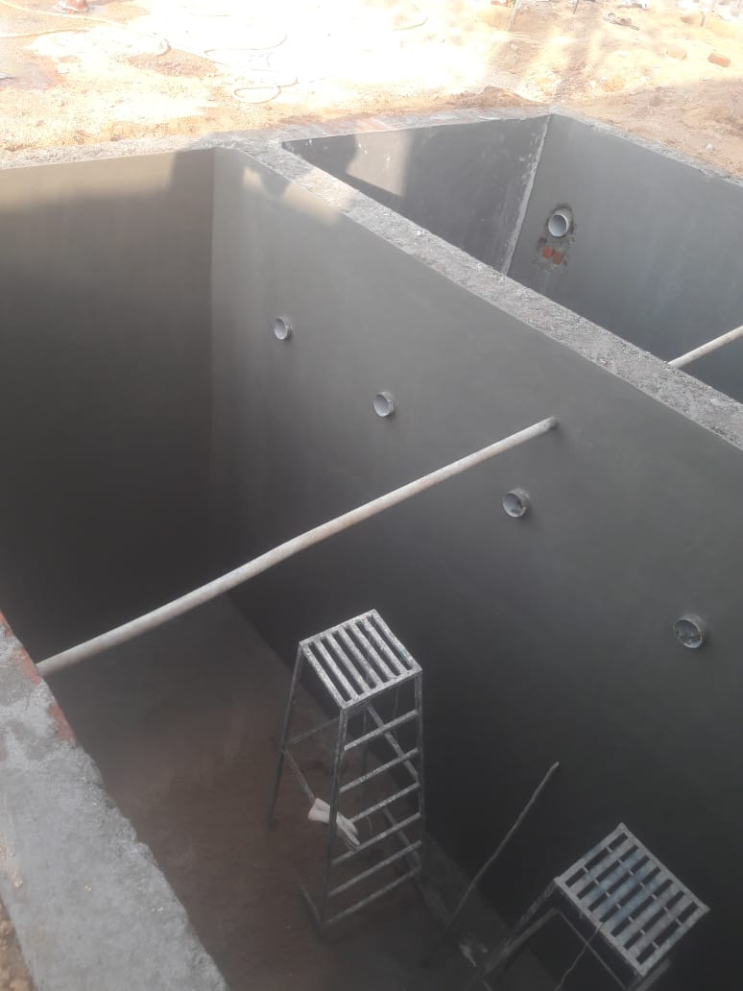
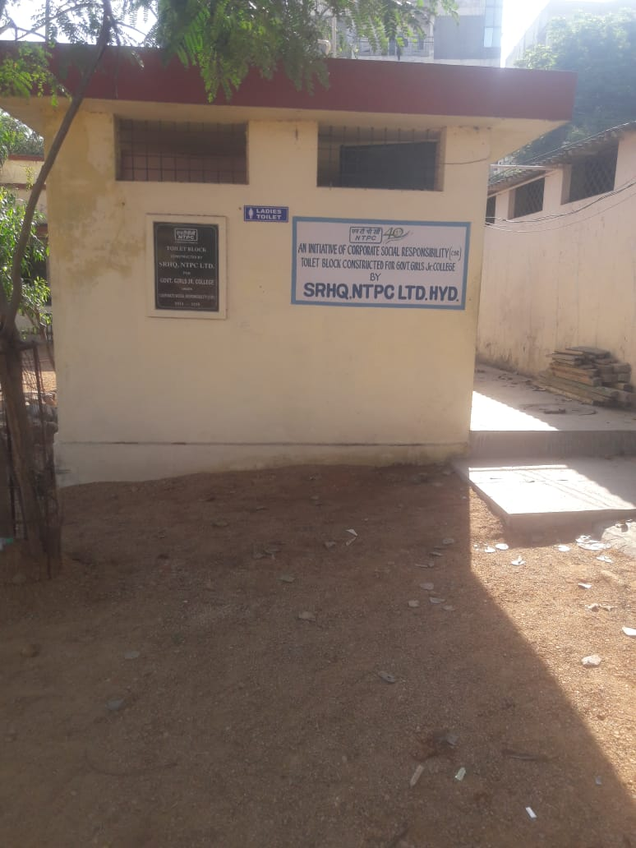
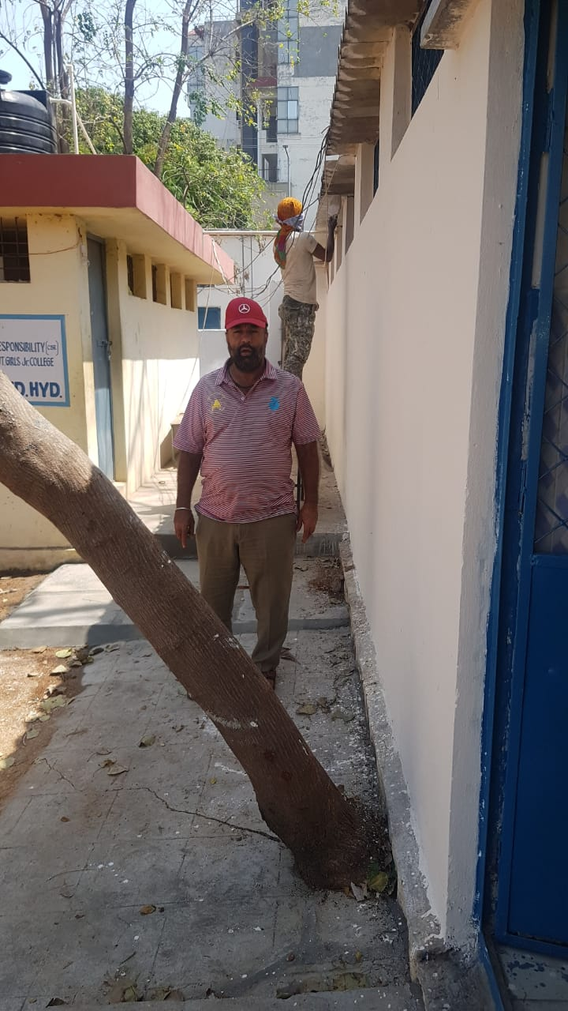
Failure and Learning – 3
WASH Project – Govt School for Girls, Secunderabad, India
Private Organisation had built the toilets which were inadequate and not functioning.
Approved Construction of Water Tank, refurbishing – building 21 Toilets, Handwash Stations, Sanitary Napkin disposal bins.
First class construction and high involvement of Rotarians.
FAILURE: The drainage was not connected to the Mains due to Geo Political reasons and the elevation.
Damage Control : Had to build a oversize Septic tank so that the toilets could be functional. For this additional fund raising and delayed inauguration of the Project
Now, 1400 Girls have a secure private toilet to relieve themselves.

Slide 5
How to do it RIGHT - Everytime
KEY LEARNINGS - 1
Involve Sector Experts : If not within your club, Approach Rotary Cadre or the Rotary Action Group such as WASRAG for advise. They have experience.
Need Assessment : This very important point is often overlooked because of the paperwork and field visits involved. We have observed that at many occasions, the requirement is overstated or sometimes understated. Both dont work.
Community Engagement and Ownership: Make sure that the Beneficiaries are actively seeking your help and are ready to participate in the project. Without that, it is a wasted effort and after the photo session of the Inaugural, the project will only go one way – Downhill.
Engineering Design and Survey: Make sure that competent personnel visit the site and make a proper assessment of what is required to make it work. Do the project if only all the required collaterals are in place or are enumerated in the project. Without that, it will remain a unused edifice

Slide 6
How to do it RIGHT - Everytime
KEY LEARNINGS – 2
Sustainability : Make sure that the Beneficiaries have the will and means to sustain the project. That they have the ability to service and repair breakdowns.
Finally, treat Rotary Funds as Sacred Funds. They have been placed in your care with a lot of trust and hope from people sacrificing some of their pleasures so that someone unknown to them can benefit and lead a better life. When this thought is applied, a lot of issues go away.
Thank you for Attending. Wishing everyone a Very Safe period ahead in these trying times.
You are most welcome to type in Questions, we will answer them after the session.
You may contact me at udaypilani@gmail.com

