Slide 1
Learning from WASH Failures: Experience from Remba Water and Sanitation project in Kenya
DEURENCE ONYANGO – deurence.adhiambo@gmail.com
RC KISUMU MASHARIKI, KENYA – D9212
July 2020 @ RI Virtual Convention

Slide 2
Presentation Outline
Description of the project
Nature of failure
Reasons for failure
Lessons Learnt

Slide 3
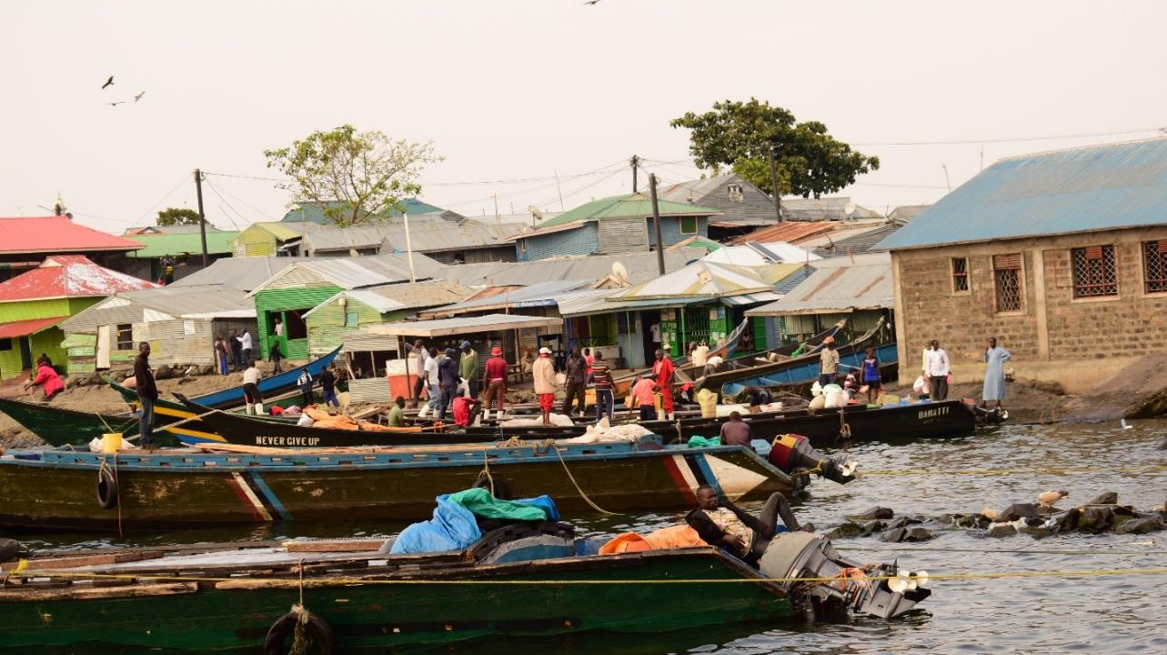
Remba Island
Small rocky and densely populated (6,000) located on the North-South border between Kenya and Uganda (<3km from Uganda)
Cosmopolitan fishing hub that hosts people from all over Africa - KE, TZ, Somali, UG, Ethiopia, DR Congo, South Sudan
Key Activities – fishing, small scale trade

Slide 4
Pre-project WASH Situation
E-coli contaminated water
Open – defecation
Non-designated garbage disposal points
Bathing in the lake
Laundry/Utensils washing in the lake
Fish preparation at the shores

Slide 5
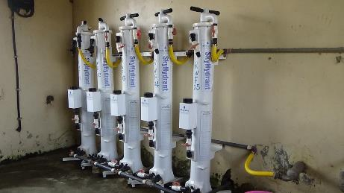
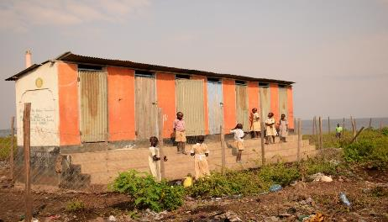
About the Project
This is a three-year Rotary global grant started in 2012 – (phase 3 currently ongoing)
Rotary Sponsored project; collaboration between RC Lacey, RC Mbita Mfangano and Pamoja CBO
Filtration (sky juice) of raw lake water; clean water pumped to residential kiosks through gravity and monitored through meters
Construction of 29-door Ecosan toilets; decomposed waste used for food production and beautification program
PMC run the day to day activities of the project
A WASH interim manager employed to steer the project

Slide 6
Component 2: The Ecosan Toilets
Community (20: in strategic points
within Island - Zain 10; Resco – 10)
School (9: 7 students;
2 for teachers)

Slide 7
How it works
Initial design: one toilet had 2-1m³chambers; each estimated to fill in 6 months
Due to population pressure, the chambers filled faster than anticipated (in 2 months) necessitating a re-design
Re-design
Solid waste: 45 kg HD plastic cartridges; treated with ash, emptied after 3-4 days at the secondary decomposing site where they are buried for about 24 months then used as fertilizer in food production and beautification
Urine – ordinary 20-litre jerricans fitted pipes are used; emptied after 3-4 days. Used for top dressing when mixed with water in the ratio 1:20
1 attendant mans 10 doors each (day/night shift); cleaning, collects money, keeps records and submits cash to WASH Committee Treasurer

Slide 8
Nature of failure
Behavioral:
Low uptake of and utility of ecosan toilets by community
Low sensitization and awareness creation
Institutional:
Poor/Low community ownership of the project
Poor local management of sanitation component of the project due to lack of training
Financial:
Low revenue collected vis-à-vis expenditure
Lack of system to track toilet use and revenue collection

Slide 9
Reasons for failure
Apathy by community on toilet use stemming from lack of sensitization of community /awareness creation on Eco-san toilets
Lack of community and stakeholder involvement and ownership in the sanitation component
Cultural reasons – buy water but not pay for call of nature
Resistance by community - minimal fee on toilet use resisted since ‘mabanga’ is free
No mechanism for tracking toilet use and revenue collection thus low revenues reported
Low revenues not sufficient to cater for attendants’ salaries and cleaning reagents
Over-dependence to donor – for maintenance due to low revenue collection

Slide 10
Lessons Learnt
Community involvement is key to the ownership and utilization of project infrastructure
Inception/review meetings
Key decisions
Assumed ownership is no ownership
Ownership of one component does not mean ownership of the other
Sensitize per component
Availability of toilets does not mean the area will be ODF.
Behavior change requires innovative complementary mechanisms like mass media campaigns, CLTS (use of CHVs), campaigns and use of IEC materials
Institutional support from relevant government bodies is integral to the success of a project
Public Health
Security/Administration
BMU

Slide 11
Thank You

