Slide 1
GLOBAL GRANTS 101
BY PROFESSOR PETER LATTEY
Notes:
INTRODUCE MYSELF -
33 YEAR ROTARIAN –
PRIMARY CONTACT ON 8 GLOBAL GRANTS –
AS CADRE ASSISTING OTHER CLUBS WITH GG
WISH I HAD THIS COURSE WHEN I STARTED

Slide 2
WHAT IS A GLOBAL GRANT PROJECT?
PARTNERSHIP BETWEEN A HOST AND INTERNATIONAL ROTARY CLUB
MINIMUM OF $30,000. AVERAGE IS ABOUT $60,000.
WITHIN 7 AREAS OF FOCUS
SUSTAINABLE
TRAINING TRAINING TRAINING

Slide 4
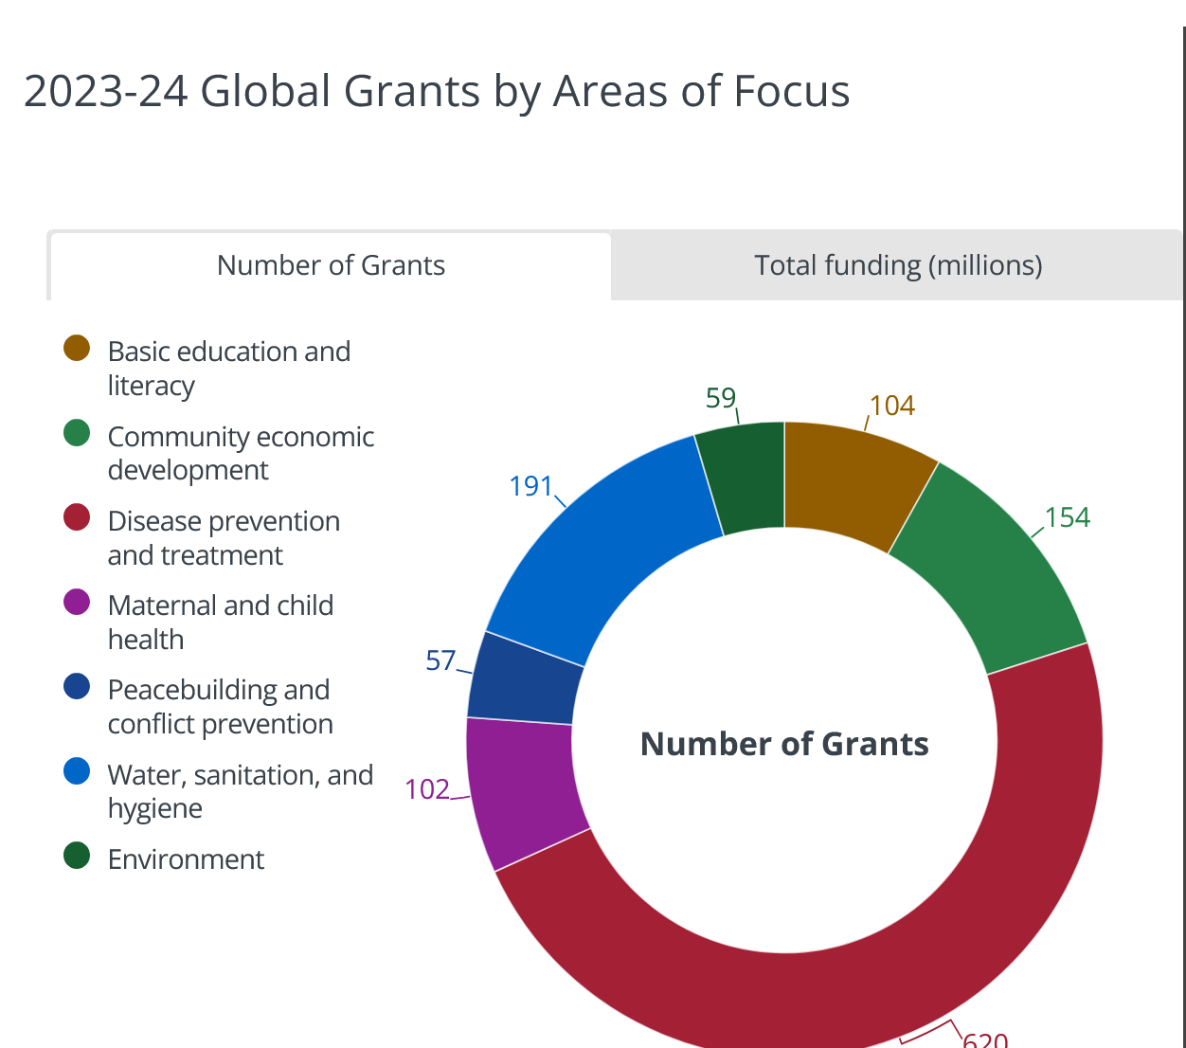

Slide 5
WASH - Water, Sanitation & hygiene
10 GRANTS IMPROVED WATER AND SANITATION AT 30 SCHOOLS IN RURAL KENYA AND 9 VILLAGES
INSTALLED RAINWATER HARVESTING AND WATER TANKS
BUILT NEW LATRINES AT 30 SCHOOLS.
STARTED A WOMAN OWNED BUSINESS MAKING REUSABLE SANITARY PADS. DISTRIBUTED SANITARY PADS TO HUNDREDS OF SCHOOL GIRLS AND TRAINED THEM IN MENSTRUAL HYGIENE .
Notes:
SOME OF MY GLOBAL GRANTS
SUSTAINABLE WATER
TRAINING FOR TUMIA TENA
MENSTRUAL TRAINING FOR GIRLS

Slide 6
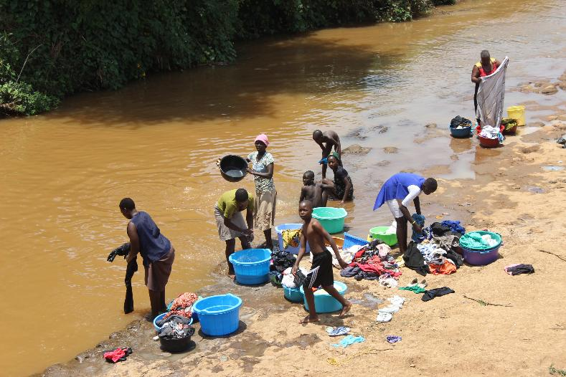
WASH GLOBAL GRANT
Notes:
SEME KAIMA RIVER - BATHING, LAUNDRY, DRINKING WATER

Slide 7
SEVEN AREAS OF FOCUS
Peacebuilding and conflict prevention
Disease prevention and treatment
Water, sanitation, and hygiene
Maternal and child health
Basic education and literacy
Community economic development
Environment
Notes:
SHOULD BE FAMILIAR TO YOU ALL
GG MUST BE IN ONE OF THE SEVEN

Slide 8
Why do a global grant?
CHANGE LIVES AND SAVE LIVES
MAKE A BIG IMPACE WHERE IT IS NEEDED
RELATIONSHIP WITH A ROTARY CLUB IN ANOTHER COUNTRY
GET A LOT OF BANG FOR YOUR BUCK
ROTARY MOMENTS
IT’S A LOT OF FUN
Notes:
It is a great way to leverage your funds.
Little Tokyo RC leveraged $1000 into a $45,000 Peace Education Project.
Palos Verdes Sunset RC leveraged $1000 into a $80,000 GG.
Redondo Beach RC leveraged $1500 into a $57000 project to provide two wells and water systems for a village of 8,000 in Kenya.

Slide 9
HOW DO YOU DO A GLOBAL GRANT ?
FIND A PARTNER CLUB
FIND A PROJECT
FIND FUNDING
WRITE THE APPPLICATION ONLINE
GET TRF APPROVAL
EXECUTE THE PROJECT
Notes:
PARTNER CLUB
QUALIFIED
COMPETENT AND INTERESTED
Personal connections with recipient countries
Information about the GG website which lists projects looking for funding and partners
PROJECTS
A FIELD THAT YOU HAVE EXPERTISE OR INTEREST IN
FUNDING
CLUBS
DDF – TRF MATCHES 80%
5280 MAYBE $2000
OTHER DISTRICTS DDF THEY MATCH CLUB CONTRIBUTIONS - SOME DISTRICTS HAVE A SURPLUS OF DDF

Slide 10
DEFINING THE project
COMMUNITY ASSESSMENT !!!!!!
LISTEN TO THE COMMUNITY
START EARLY WITH THE APPLICATION
ASK FOR HELP
LOCAL RESOURCES
CADRE
Notes:
LISTEN TO THE COMMUNITY

Slide 11
$$$$ SHOW ME THE MONEY $$$$$
ONE PAGER PITCH
PARTNERSHIPS – LOCAL, NGOS,
OTHER ROTARY CLUBS
INDIVIDUALS
DDF MATCHING 80%
Notes:
Rotary Clubs. Outside foundations, non-profits, individuals, Corporations
Shake a lot of money trees
5% admin charge by TRF
Leverage of funds
District Designated funds DDF. Where they come from and how do they get spent.
50% District projects 50% Global Grants
How are DDF allocated by 5280 district
How you can access DDF in other districts
TRF matching funds. How does this work. DDF is matched 80%

Slide 12
The grant application
ONLINE – START, GET A NUMBER AND TAKE A LOOK
A LOT OF STUFF BUT NOT HARD
SUBMIT ANY TIME
LOTS OF DOCUMENTS NEEDED

Slide 13
international club ROLE
HELP DEFINE THE PROJECT
PARTNER IN WRITING THE GRANT APPLICATION
FUNDRAISING
OVERSIGHT
PARTNER IN REPORTING

Slide 14
host club ROLE
COMMUNITY ASSESSMENT TO DEFINE THE PROJECT
PARTNER IN WRITING THE GRANT APPLICATION
FUNDRAISING
PROJECT MANAGEMENT / FUNDS CONTROL
MONITOR RESULTS
PARTNER IN REPORTING
CHASE AWAY THE HIPPOS
Notes:
They are local and know the local situation.
Keep the Hippos away.

Slide 15
How long does it take
3 PHASES
1. WRITING APPLICATION & FINDING THE MONEY. 6 TO 9 MONTHS
2. APPROVAL BY TRF 4 TO 8 WEEKS
3. EXECUTION. DEPENDS - MOST UNDER 12 MONTHS

Slide 16
Who are the ROTARY Cadre ?
1500 ROTARIANS TO HELP YOU
VOLUNTEER ROTARIANS
EXPERTISE IN AN AREA OF FOCUS
REGIONAL EXPERTISE
PROJECT PLANNING AND IMPLEMENTATION
3 IN 5280
ASK FOR THE LIST CADRE DIRECTORY

Slide 17
??????????????? help ?????????????????
YOU ARE NOT ALONE
A GUIDE TO GLOBAL GRANTS
CADRE EXPERTS
EXPERIENCED ROTARIANS
DISTRICT GRANTS OFFICER

Slide 18
FOR HELP CONTACT ME
PETER LATTEY
+1 310-968-3252
PETER@PETERLATTEY.COM

